Slide 1
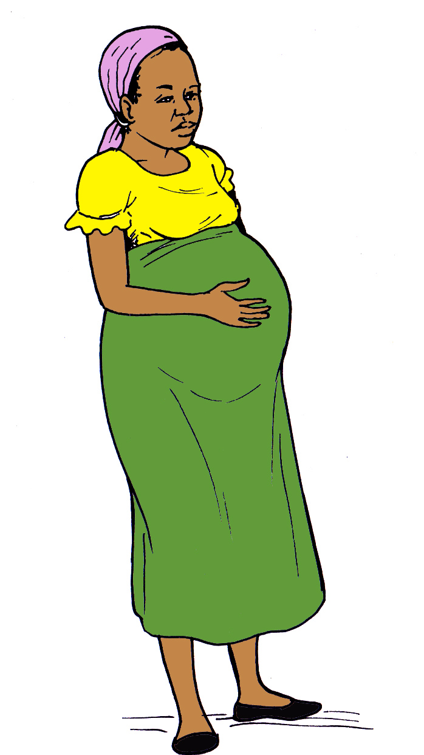
Guide to Pregnancy

Slide 2
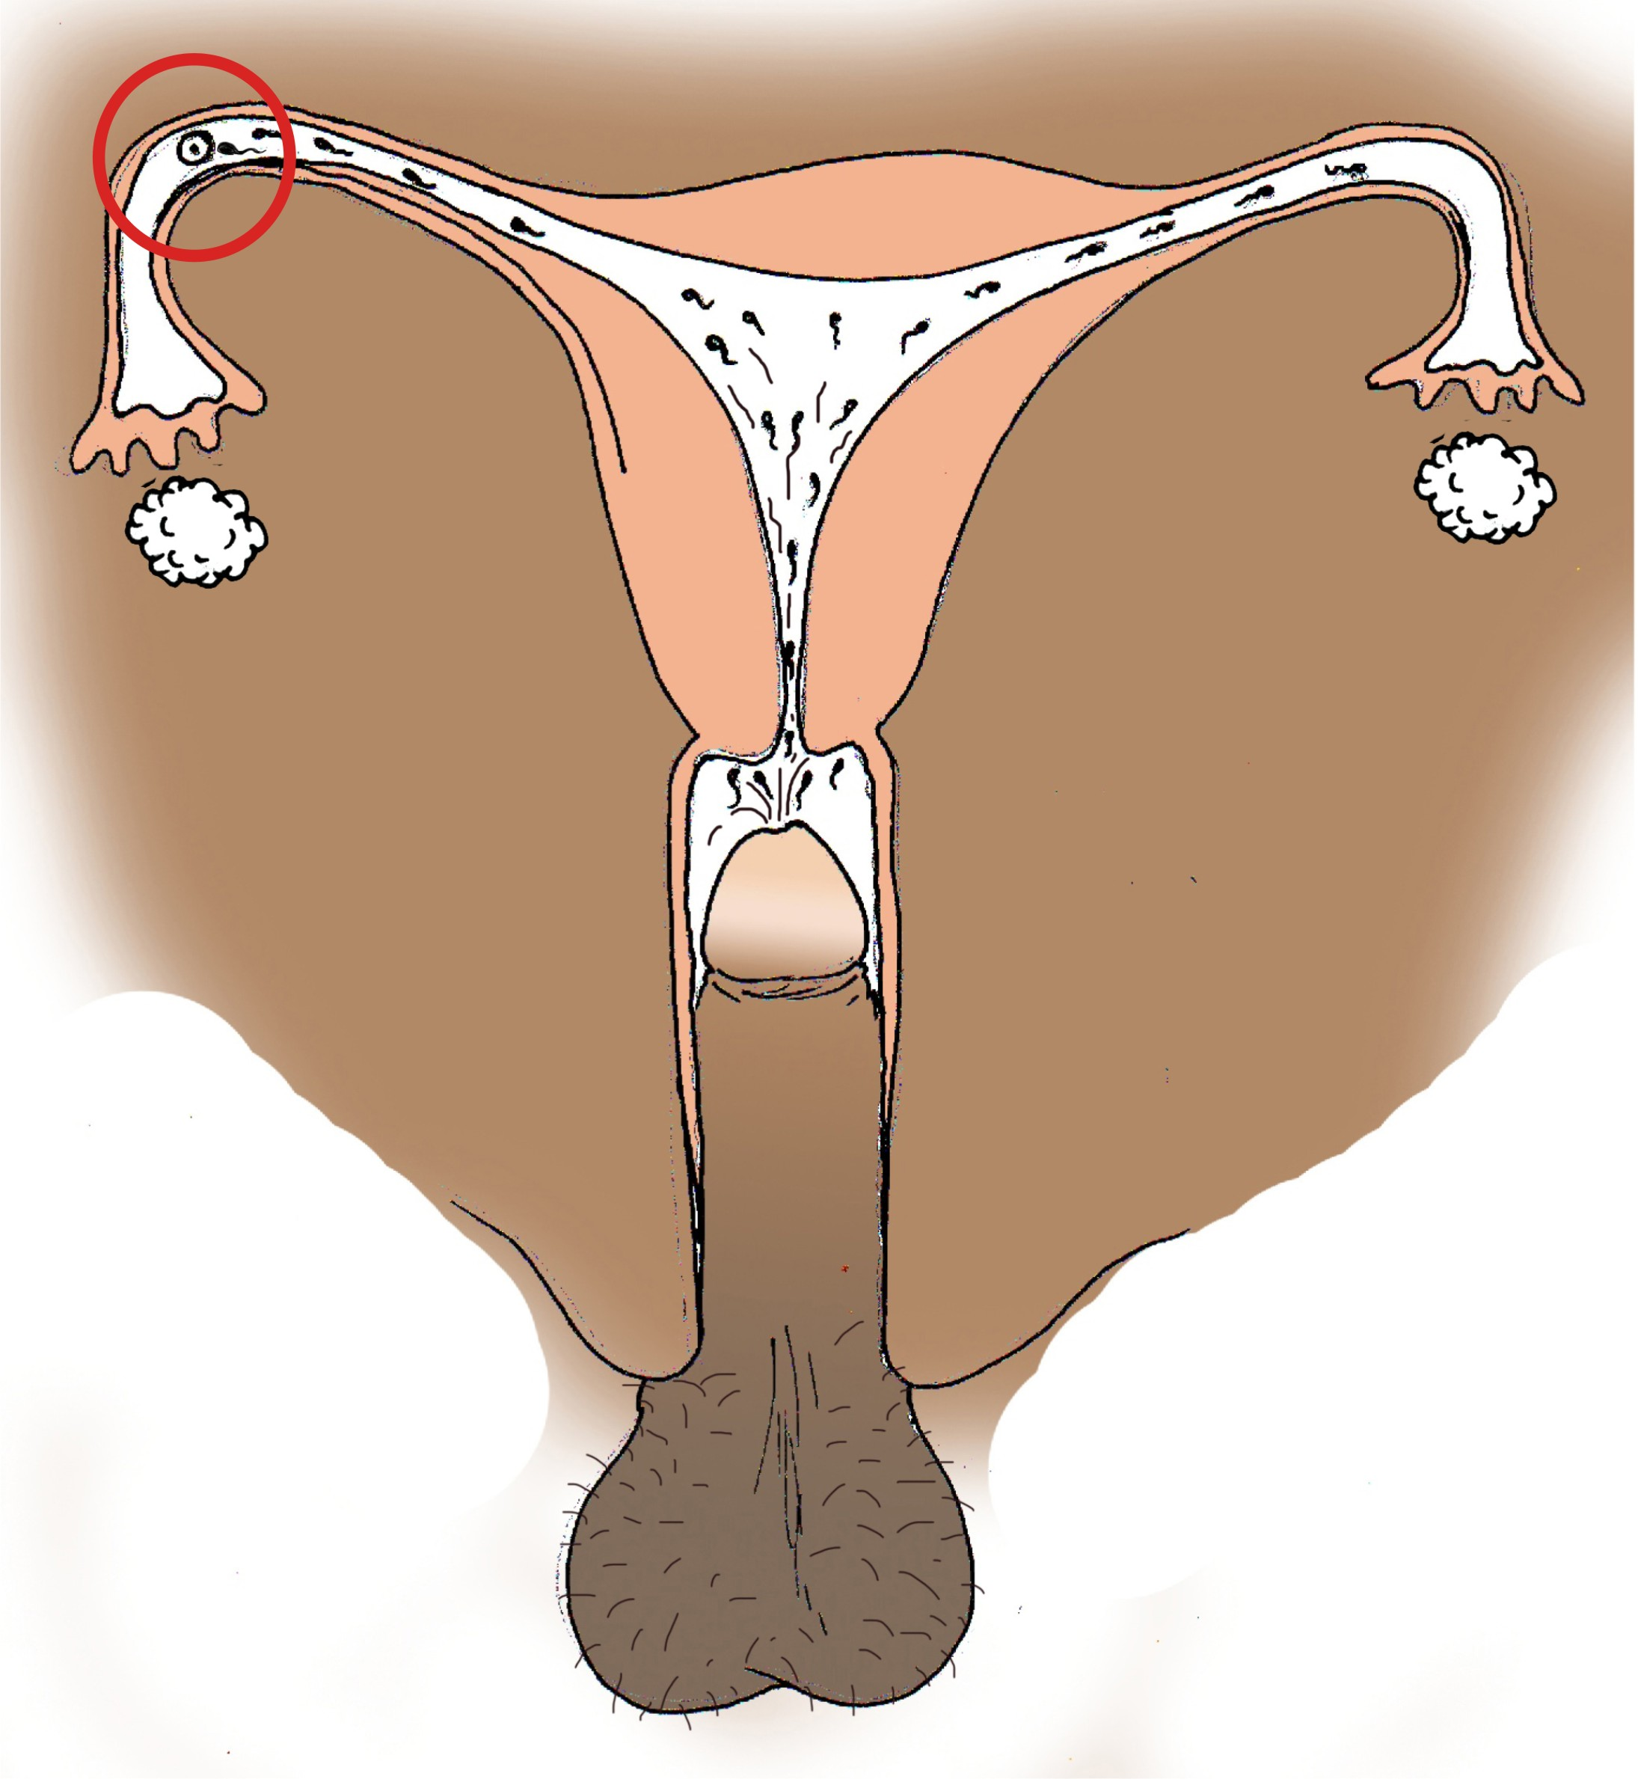
Basics of pregnancy
A woman can become pregnant after she has unprotected sex.
The sperm released from the man’s penis during sex swims up through the woman’s cervix and uterus
The sperm meets the egg in the fallopian tube
Notes:
Make sure the illustration shows the fertilization in the fallopian tube

Slide 3
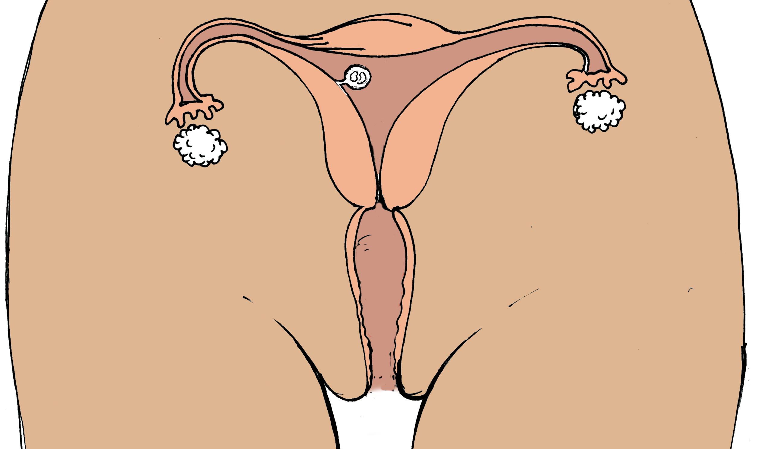
pregnancy
Once the egg and sperm have joined together, they form an embryo, which attaches to the inside of your uterus and starts growing into a baby
Because the embryo is attached to the uterus, you will not bleed and you will miss your period--this is the first sign of pregnancy
It takes 40 weeks for the baby to grow

Slide 4
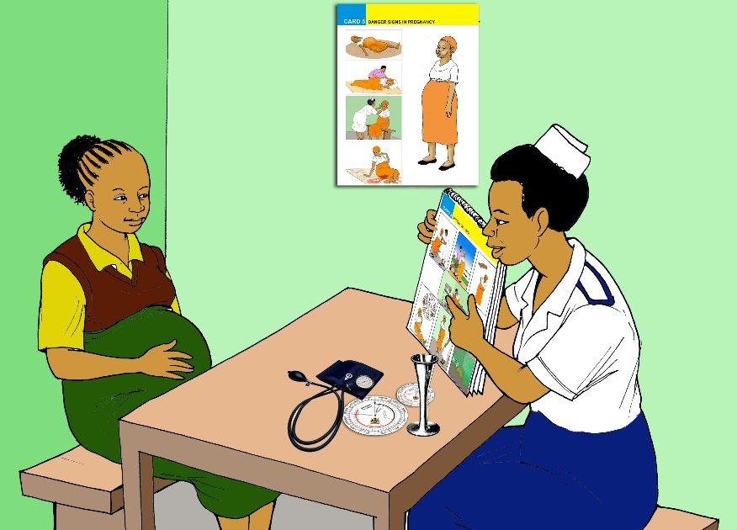
Antenatal care
You should keep track of your menstrual cycles
You should go to the health centre as soon as you know you are pregnant
You should plan to attend antenatal care visits at least 4 times during your pregnancy and more if there are complications

Slide 5
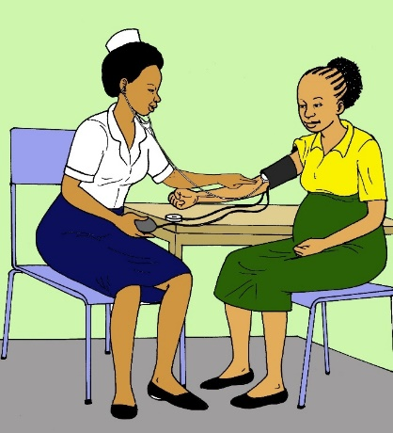
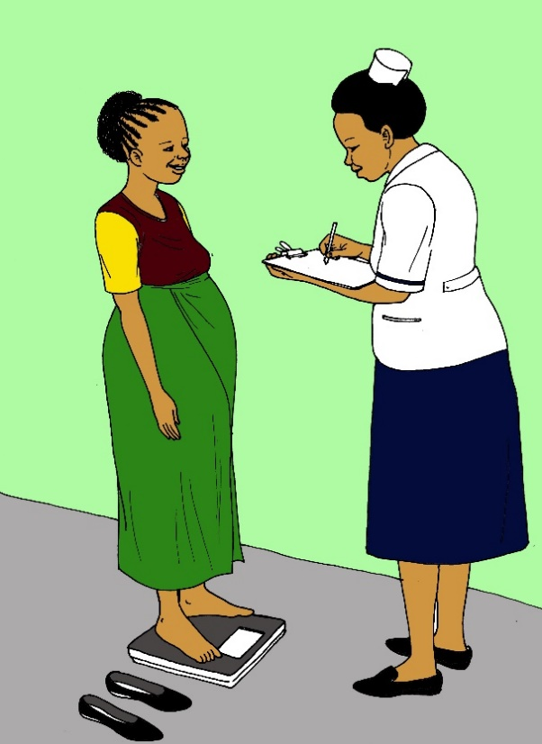
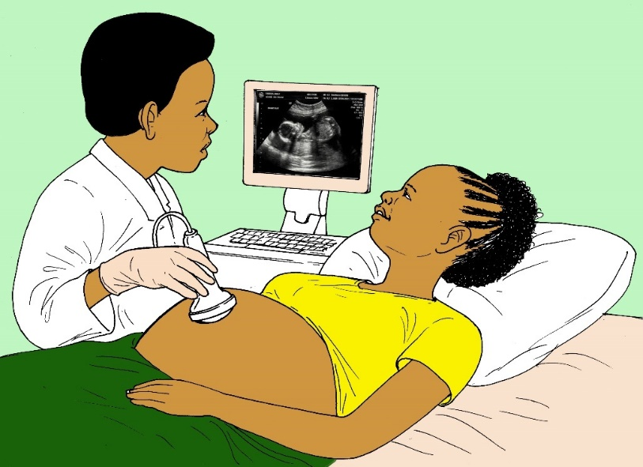
antenatal care
At your antenatal care visits, you will receive testing to ensure your pregnancy is healthy
Receiving regular antenatal care can help identify if you are at risk for preterm labor

Slide 6
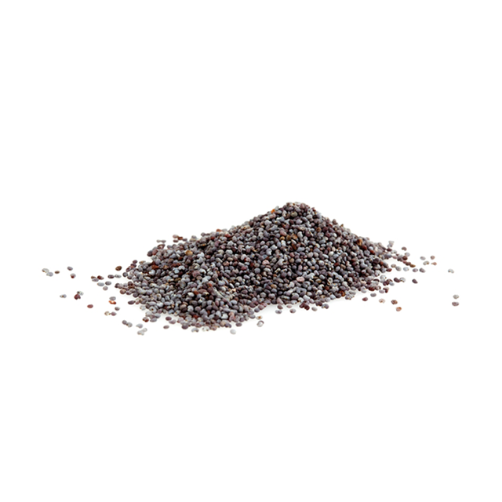
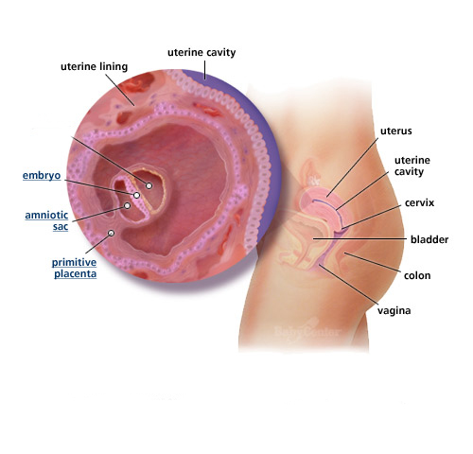
WEEk 0-4
Your baby is very tiny, the size of a millet seed
The amniotic sac (bag of fluid that surrounds the baby) and placenta will develop
You likely will not experience any symptoms during this time, but some you might feel mild bloating, cramping, spotting or mood swings

Slide 7
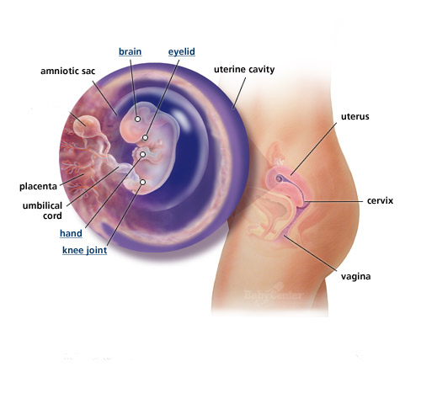
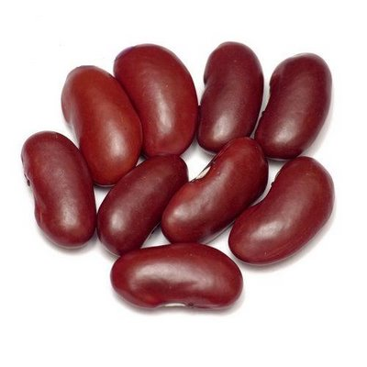
WEEk 5-8
The baby’s brain, heart, lungs, and kidneys are developing
The baby’s arms and legs start to grow, and the baby starts to move (but you won’t feel it yet)
You may experience nausea and vomiting, mood swings, sore breasts, fatigue, and heightened sense of smell
By week 8, your baby is the size of a kidney bean
1cm

Slide 8
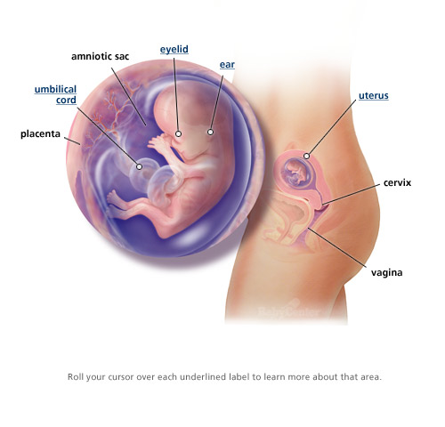
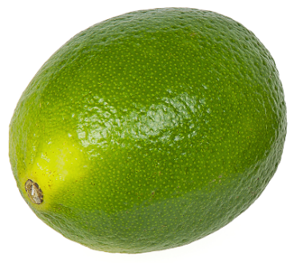
WEEk 9-12
The baby starts to develop fingers and toes
The baby’s eyes and ears have developed, but the eyelids are shut
The baby’s mouth is developing
You may notice your clothing feels tighter
You may start to have constipation and heartburn
By week 12, your baby is the size of a lime
5cm

Slide 9
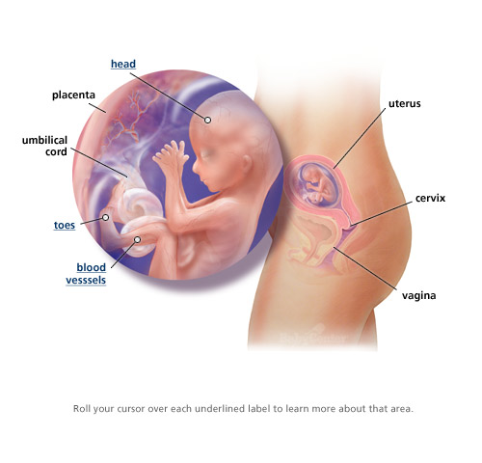
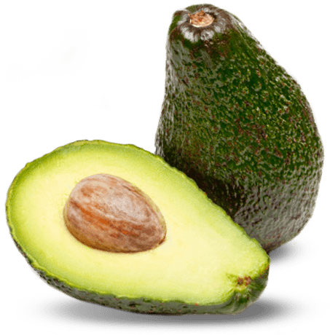
WEEk 13-16
Your baby will start it’s own blood and urine
Your baby can now make faces
Vomiting should stop by this time in the pregnancy, and your belly will continue to grow
By week 16, your baby is the size of an avocado
12cm

Slide 10
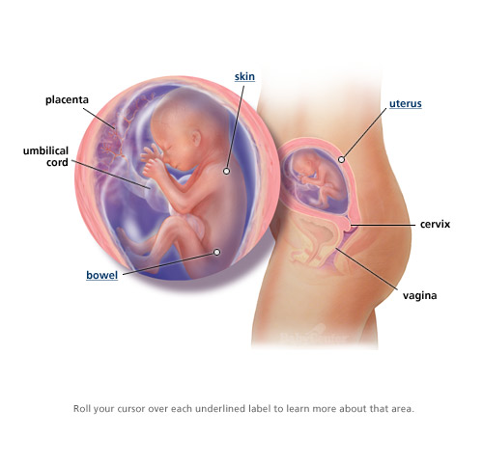

WEEk 17-20
Your baby’s senses are developing
Hair is growing on your baby’s head
You will start to feel your baby move
Your belly will be growing much bigger
You can see the baby’s gender on ultrasound
By week 20, your baby is the size of a banana
16cm

Slide 11
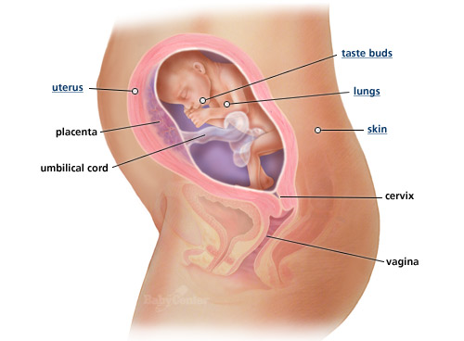
WEEk 21-24
Your baby’s lungs are developing
The baby can hear you talking
You may start to develop stretch marks on your belly and thighs
You may also notice mild swelling of your legs and ankles
By week 24, your baby is the size of a cantaloupe

Slide 12
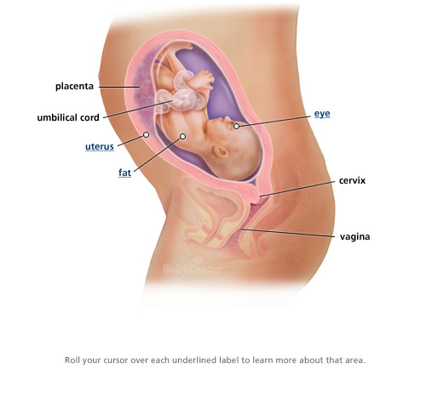
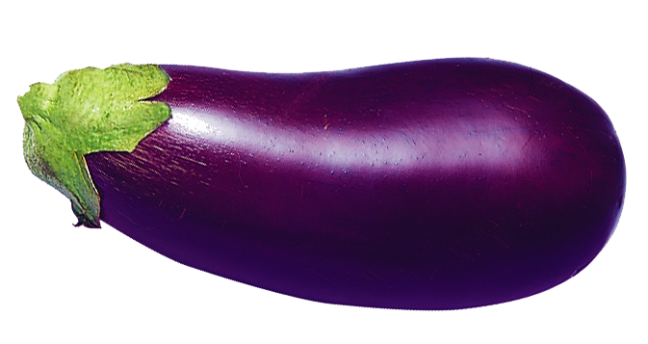
WEEk 25-28
Your baby is starting to sleep and wake up at regular times
You may feel your baby start to hiccup
You may start developing leg cramps and back pain
By week 28, your baby is the size of an aubergine
38 cm

Slide 13
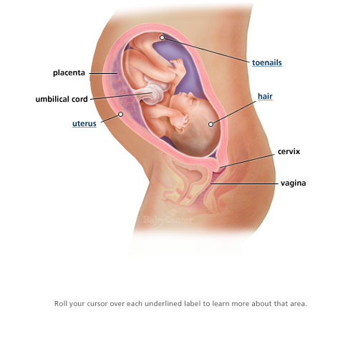
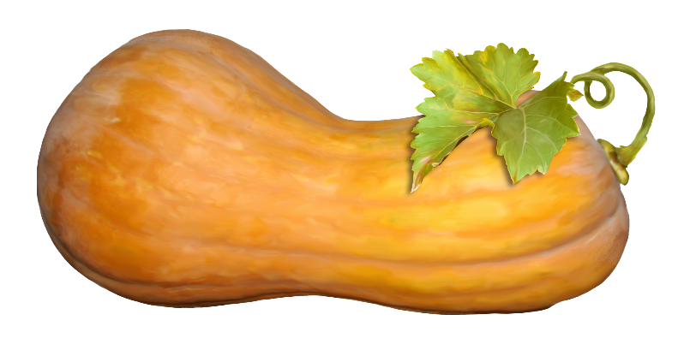
WEEk 29-32
Your baby’s brain is growing so the head is getting much bigger
Your baby will be much more active, and you will feel kicking more often
You may feel dizzy if you stand up too quickly
You may have heartburn, constipation, or hemorrhoids
By week 32, your baby is the size of a squash
42 cm

Slide 14
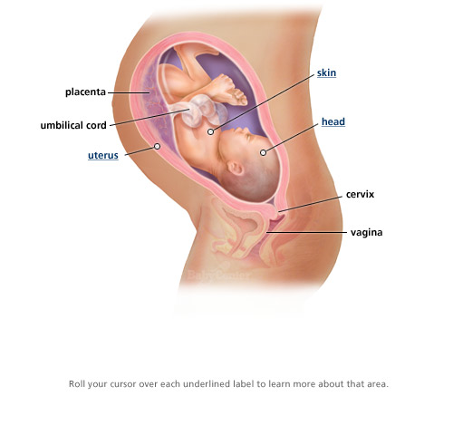

WEEk 33-36
Your baby has finished developing and is now just growing in size
You may have trouble sleeping
You may have trouble breathing when walking long distances
You may also feel some irregular, mostly painless contractions—these are called Braxton Hicks contractions and are different from labour contractions
By week 36, your baby is the size of a pineapple
46 cm

Slide 15
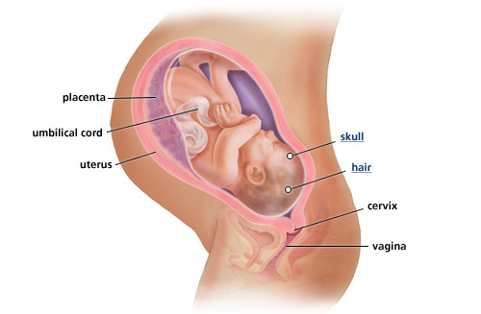
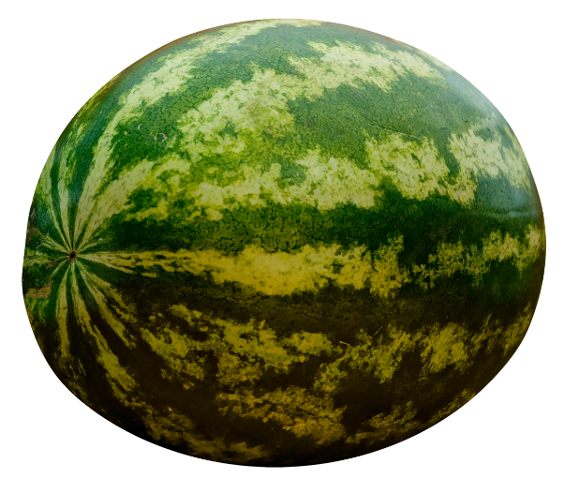
WEEk 37-40
Your baby is adding fat to his body to help control body temperature after birth
You may start to notice some leakage of milk from your breasts
If you do not deliver by week 40, you should go to the health center for an evaluation
By week 40, your baby is the size of a watermelon
51 cm

Slide 16
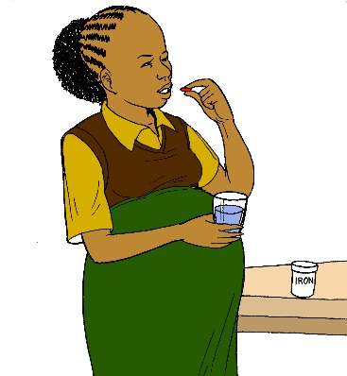
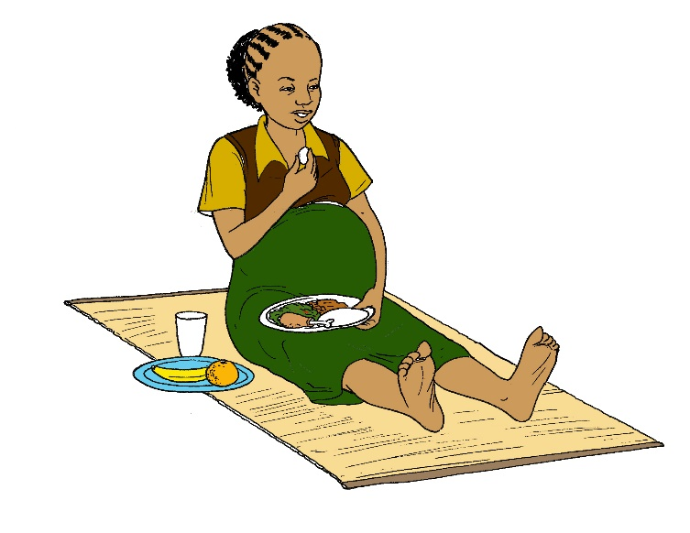

how do you keep your pregnancy healthy?
Attend antenatal care visits
Take iron supplements
Eat a healthy diet
Don’t smoke
Don’t let anyone hurt you

Slide 17

Iron supplementation
Iron-deficiency anaemia is a decrease in the number of red blood cells in the body due to a lack of iron
Women who are anaemic are more likely to deliver a baby preterm
Women who take iron supplements during pregnancy are less likely to be anaemic and less likely to have complications in their pregnancy

Slide 18

Good Nutrition
Pregnant women should have balanced diets with foods from all six of food groups: staples, fats, animals, legumes, vegetables, and fruits
Women who eat too little or do not eat the right foods have an increased risk of complications in pregnancy, including anaemia and preterm delivery

Slide 19
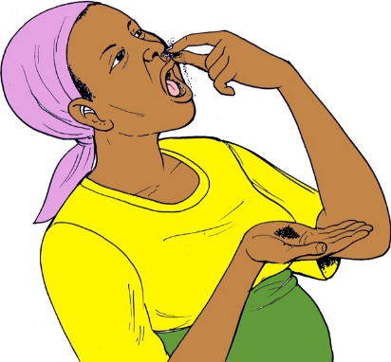
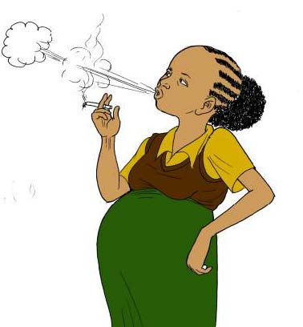
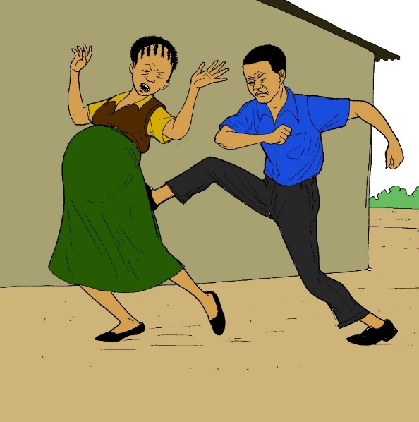
You are more likely to deliver your baby too early if…
You smoke or chew tobacco leaves during pregnancy
Your partner or someone else is hurting you

Slide 20
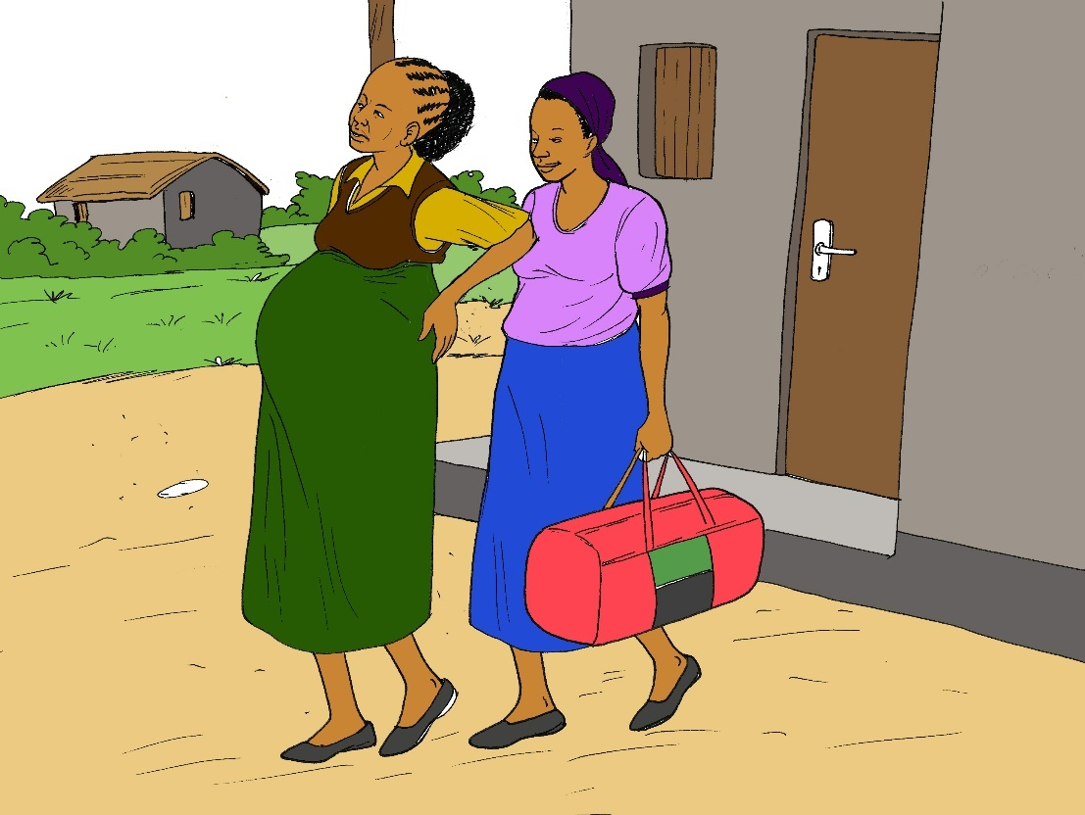
When should you go to the health centre?
You have regular, painful contractions
You are leaking water from the vagina
You are bleeding from the vagina
The baby is not moving or is not moving as much as before
You have not delivered by week 40

Slide 21
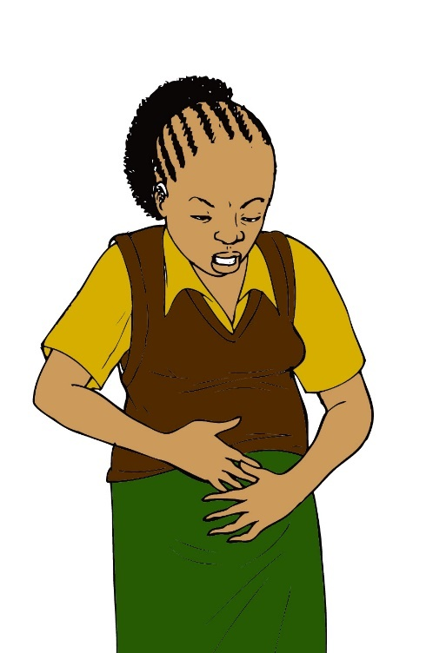
contractions
Contractions might feel like severe menstrual cramps
The pain may start in your back or in your belly
Labor contractions come at regular intervals
They become more painful over time

Slide 22
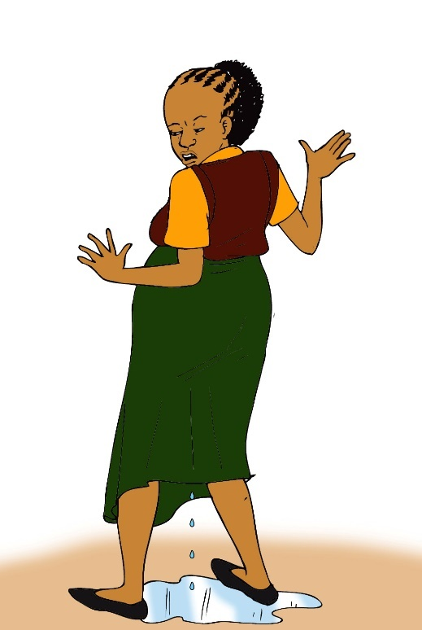
Leaking of fluid
The water that surrounds the baby is called amniotic fluid
When your “water breaks,” the sac surrounding the baby opens and the fluid comes out the vagina
The fluid might come out in a big gush or it might leak out in small amounts

Slide 23
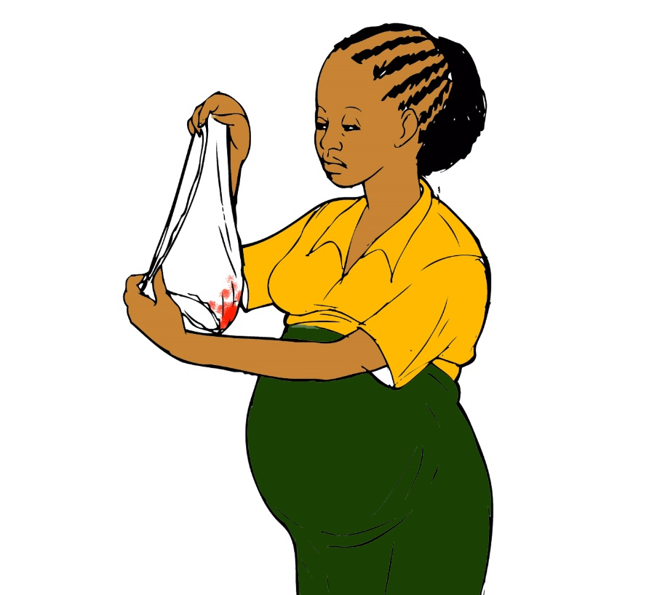
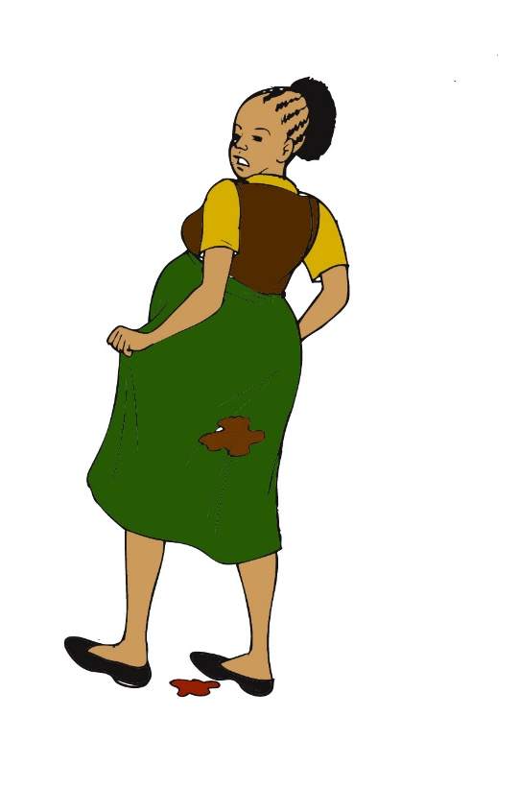
Vaginal bleeding
Vaginal bleeding or spotting early in the pregnancy is associated with an increased risk of preterm labor
If the bleeding happens multiple times or on multiple days, this might be a sign of preterm labor

Slide 24
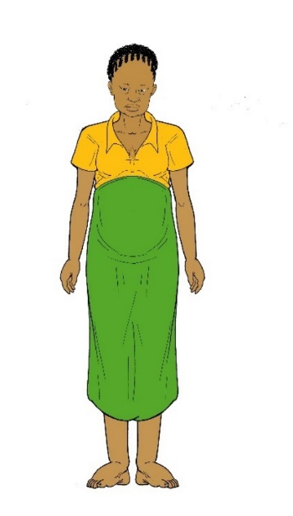
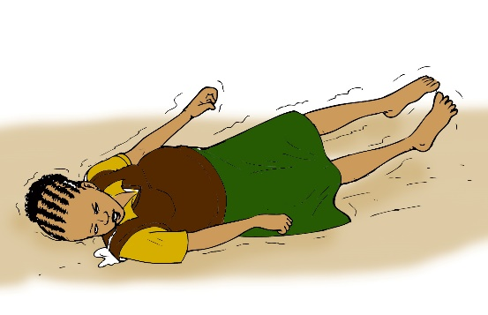
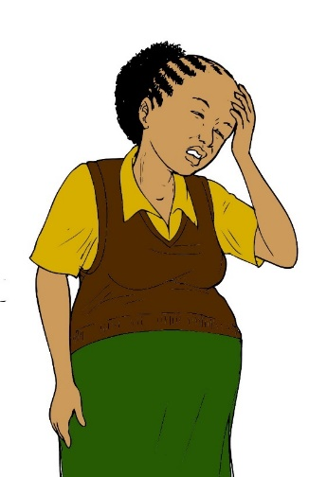
High blood pressure
If you have any of the symptoms of high blood pressure, you should go to the health centre immediately
Abdominal pain
Severe headaches
Blurred vision
Swelling of the face, hands, or feet
Seizures
High blood pressure can be life-threatening during pregnancy
If you have high blood pressure, you might need to deliver the baby early
Seizures
Swelling
Headache

Slide 25
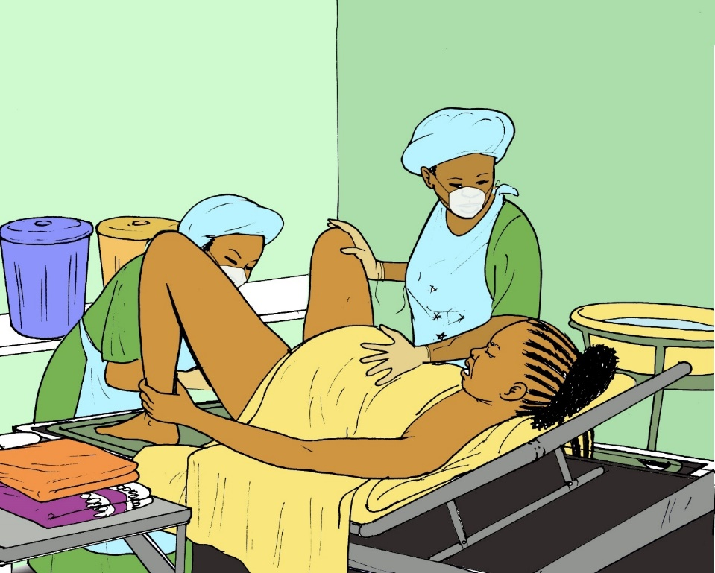
What will happen at the health centre?
You will be evaluated by a skilled birth attendant so that you and your baby will be healthy
If you are sick or the baby is preterm, you may be sent to the nearest hospital for care by a specialist
If you are in labor, you will deliver the baby
You might have a vaginal birth
You might require a Caesar

Slide 26
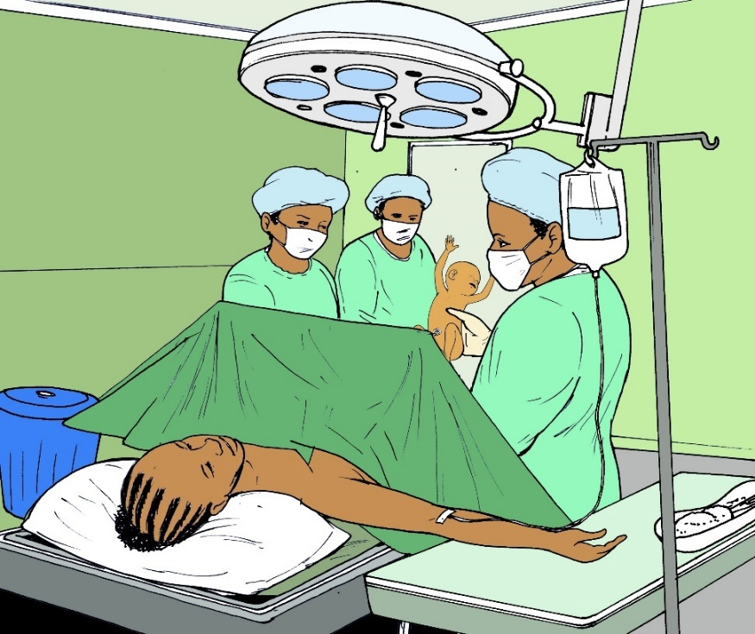
Having a Caesar
Caesars are performed in the operating theater
During a Caesar, the surgeon will deliver the baby through an incision in the abdomen
Women who have infections, problems with the placenta, or chronic health conditions such as diabetes are more likely to need a Caesar

Slide 27
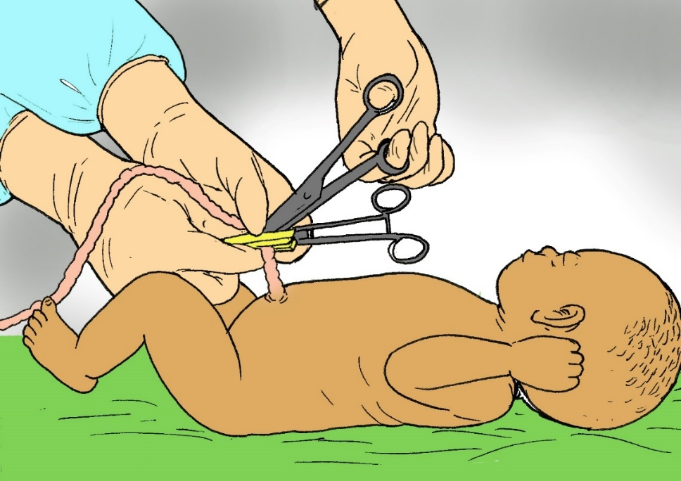
After delivery
The umbilical cord runs from an opening in the baby’s stomach to the placenta
Once the baby is born, there is no need for this connection anymore
After a birth, the umbilical cord should be clamped or tied and cut with a clean instrument to avoid infection

Slide 28
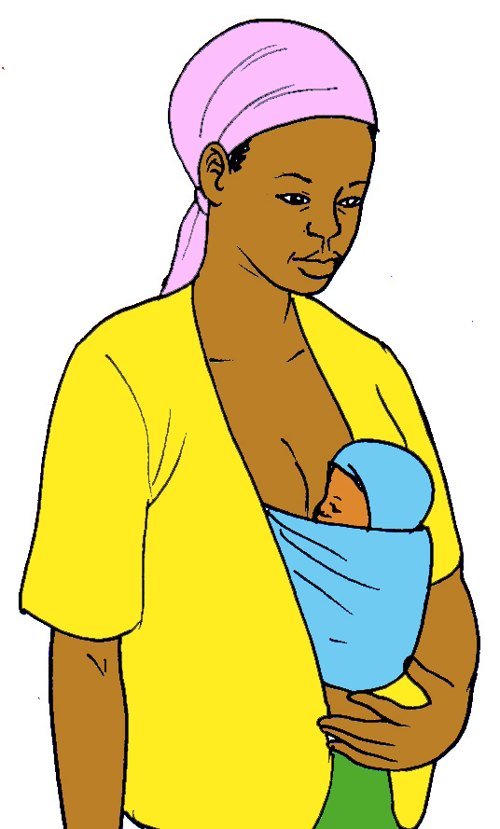
Kangaroo care
It is very important that the baby is kept warm after delivery
To do this, you should put the baby on your chest directly on your skin and wrap a blanket or a chitenje around the baby
Carrying the baby wrapped this way is called “kangaroo care”

Slide 29
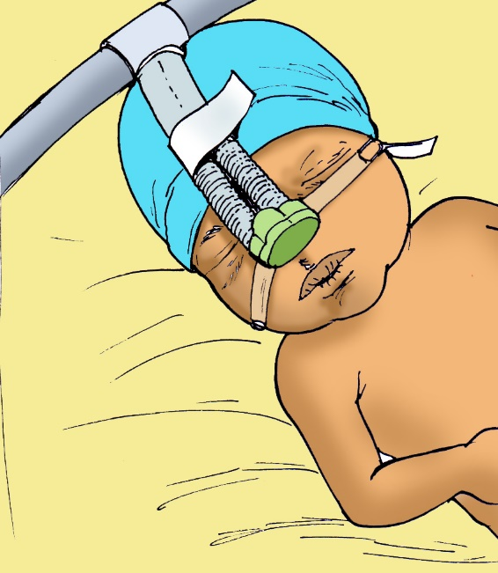
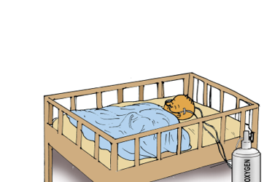
HOSPITAL CARE FOR BABY
Preterm babies are sometimes sick and require help with breathing
The baby may need to stay in the hospital for special care

Slide 30
What is preterm delivery?
Pregnancy lasts 40 weeks
If your labor begins before the 37th week of pregnancy, you are in preterm labor
Preterm delivery is the most common cause of death in newborn babies
In Malawi, 1 in every 5 babies is born preterm

Slide 31
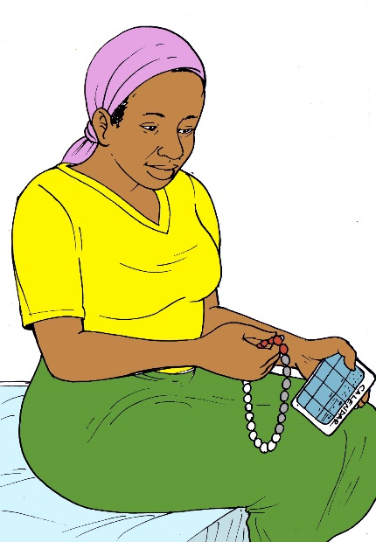
How do I know if my baby is preterm?
Keep track of your period using
A calendar
Beads
Your phone
Your health care provider will use the first day you bled to calculate your due date
A full term pregnancy is 40 weeks
If you have the baby more than one month before your due date, your baby is preterm

Slide 32
Why is preterm birth a problem?
Babies born too soon can have many problems
Difficulty breathing
Infections
Low blood sugar
Low body temperature
Seizures
Injury to brain

Slide 33
How do I prevent preterm delivery in future pregnancies?
Pregnancy Spacing
Prevent or Treat Infection
Contraception

Slide 34
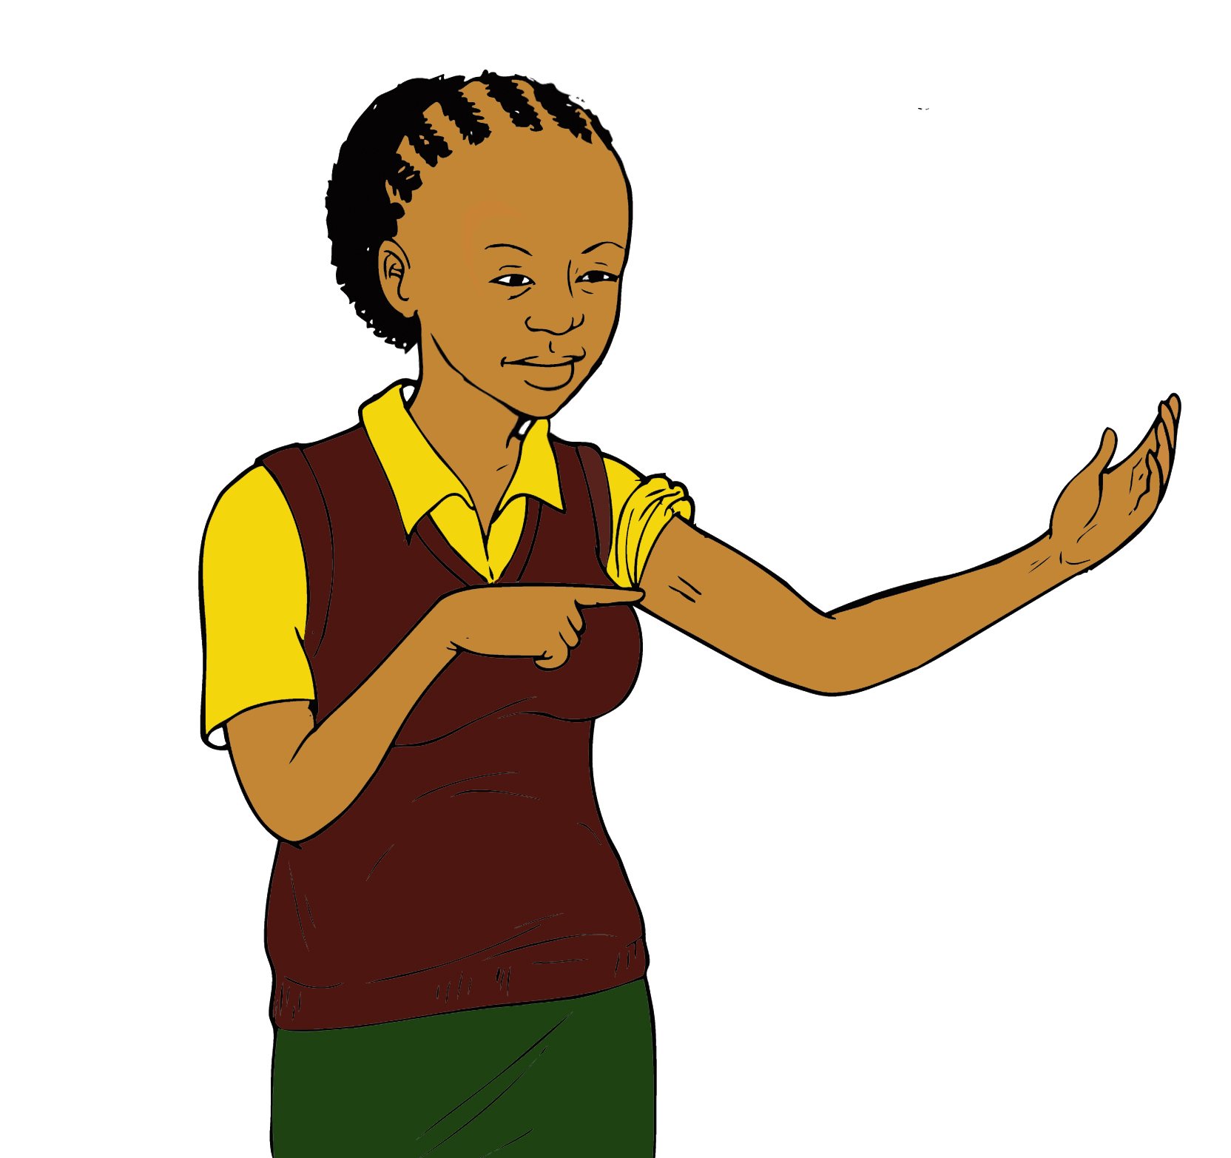
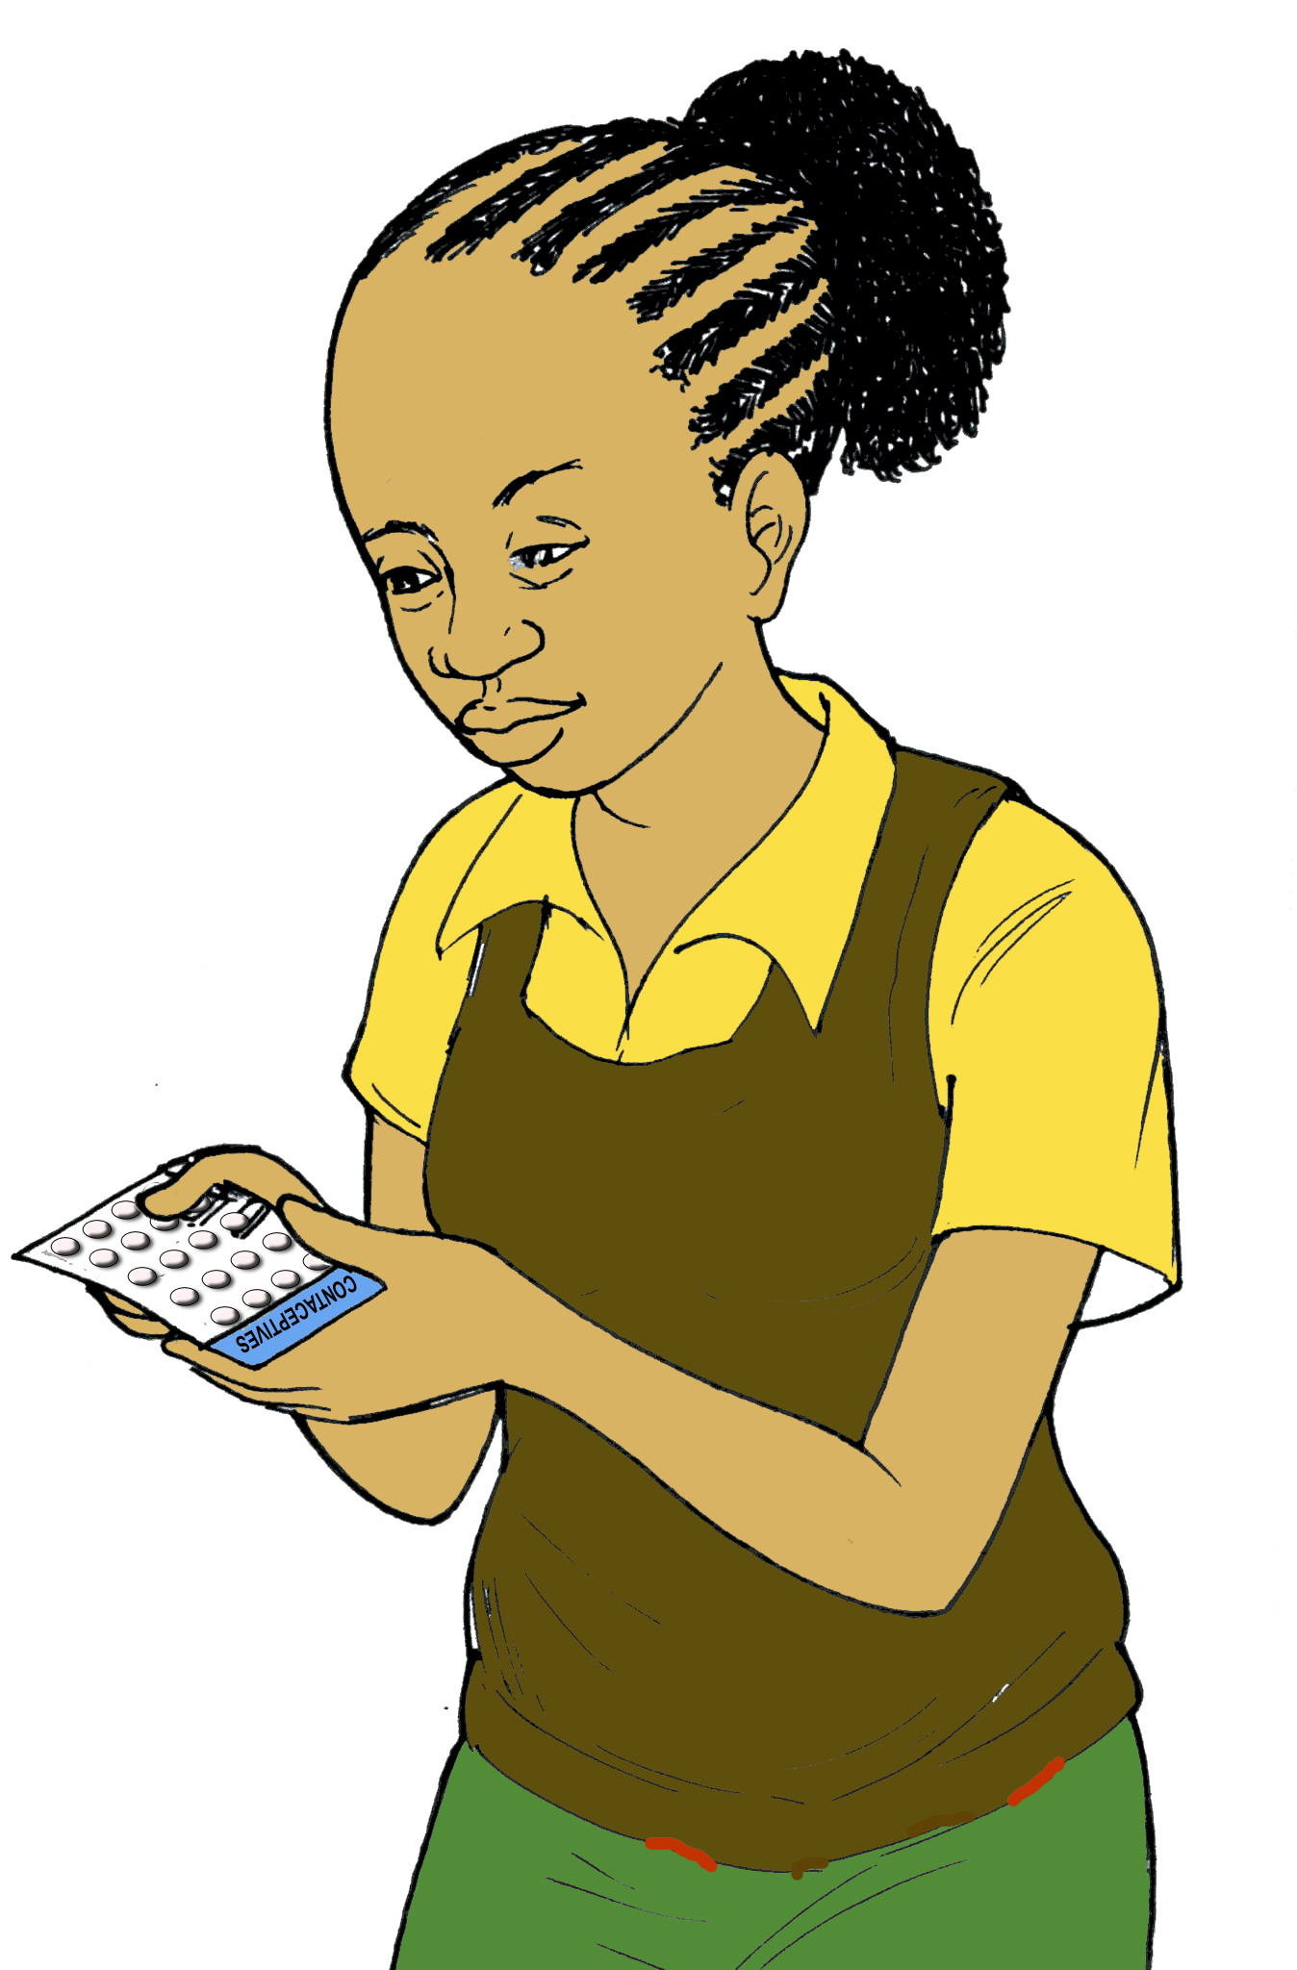
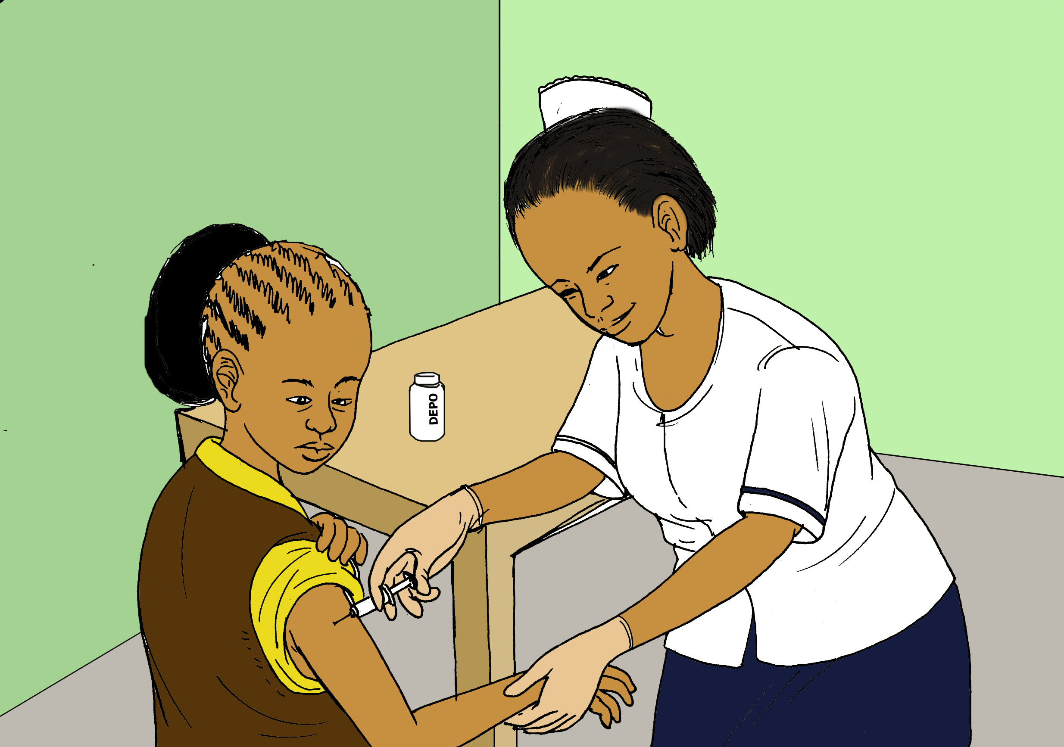
PREGNANCY SPACING
Waiting at least 2 years between pregnancies will decrease the chance of preterm labor
If you are sexually active, it is best to use contraception to prevent pregnancy and condoms to prevent infection
Implant
Birth Control Pills
Injectable Hormones

Slide 35

PREVENT INFECTION
Infection in any part of the body increases the risk of preterm birth
It is important to prevent infection and to treat any infection that you already have
When the mom is HIV+, preterm babies are more likely to be born with HIV than full term babies
It is important to continue taking your medications for HIV or any other infection throughout pregnancy

Slide 36




Acknowledgments
©2018 Baylor College of Medicine Abbott Fund Children’s Clinical Centre of Excellence Malawi, Lilongwe, Malawi
Illustrator: Rogers Chilemba
Creator:
Susan Raine, MD, JD, LLM, MEd
Jane Morris, MD
Contributors/Translators:
Deborah Nanthuru
Abiba Matengula
A special thanks to our patients for their valuable input

